Slide 1

Data Exfiltration & Its Detection Techniques

Slide 2

#whoami
👉 Chirag Savla
👉 Twitter – @chiragsavla94
👉 Interest area – Red Teaming, Application Security, Penetration Testing
Blog – https://3xpl01tc0d3r.blogspot.com

Slide 3
As an offensive researcher, if you can dream it, someone has likely already done it… and that someone isn’t the kind of person who speaks at security cons.
— Matt Graeber

Slide 4
Agenda
DNS attacks
PNG & ICMP attacks

Slide 5
DNS attacks
Data Exfiltration over DNS & DNS Tunneling
Detection Metrics
Visual Inspection

Slide 6
About DNS
The Domain Name System (DNS) is a system designed so we as humans don’t have to remember IP addresses when browsing the internet.
DNS Protocol is mainly designed to resolve a hostname query to an IP address response.
The query is performed recursively, starting from the root DNS name servers until reaching the authoritative name server defined for queried domain.
Notes:
The number of attacks on Internet services has been on the rise since the Internet became available to the general public. One of the services that has also been attacked using various ways is the Domain Name System (DNS) service. The DNS is one of the most important parts of the Internet. Without it, people would not be able to connect to favorite websites or check their e-mail.
It is not hard to imagine that DNS servers have also been the targets of attacks. These attacks are possible because of exploits in the DNS protocol or bugs in the DNS software. There is also a group of attacks that overload a host with packets taking up massive amount of bandwidth and processing power in the hope of making the DNS server unavailable for genuine users. These attacks are called Denial of Service (DoS) attacks. The reasons for these attacks differ: for example a DNS cache poisoning attack is used to get control over a domain, while DoS attacks just want to disrupt normal service. Although system administrators are continuously adding new lines of defense to protect their infrastructure, the new generation of attackers is continuously trying new approaches to find ways to circumvent these defenses.
Detecting attacks involving DNS servers, using high level flow data gathered at routers.

Slide 7
Data Exfiltration over DNS & DNS Tunneling
DNS Data exfiltration is way to exchange data between 2 computers without any directly connection, the data is exchanged through DNS protocol on intermediate DNS servers
DNS Tunneling is a method that encodes the data of other programs or protocols in DNS queries and responses.
Why DNS ?
A cornerstone of the Internet; available in almost every network
Rarely monitored compared to HTTP, FTP and e-mail protocols

Slide 8
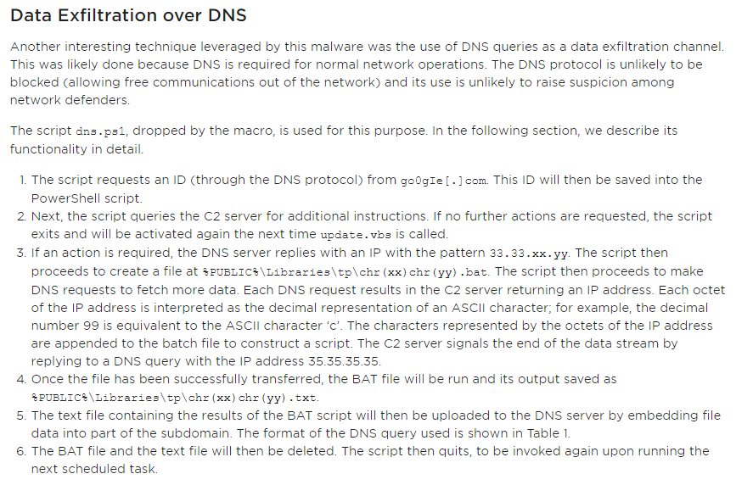
Targeted Attacks against Banks in the Middle East
https://www.fireeye.com/blog/threat-research/2016/05/targeted_attacksaga.html

Slide 9
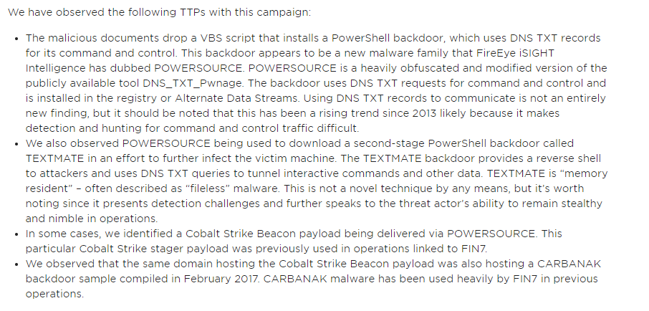
FIN7 Spear Phishing Campaign Targets Personnel Involved in SEC Filings
https://www.fireeye.com/blog/threat-research/2017/03/fin7_spear_phishing.html

Slide 10
Demo Time
This is not rocket science.

Slide 11
Detection Metrics
Lots of requests to domains/single domain
Spike in DNS byte count across normal traffic patterns
MD5, SHA1, SHA256 hashed subdomains
Encrypted payloads
Plain text requests of subdomains
DNS replies have private addresses
DNS replies have single IP address
DNS replies have patterned encoding
Packet size outside the normal distribution
Pattern of many requests to specific domains in round robin pattern

Slide 12
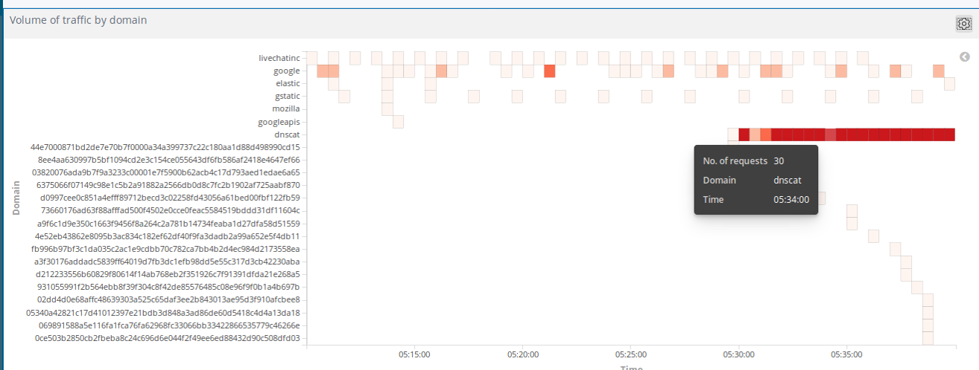
Detection Metric 1 - High volume of traffic

Slide 13
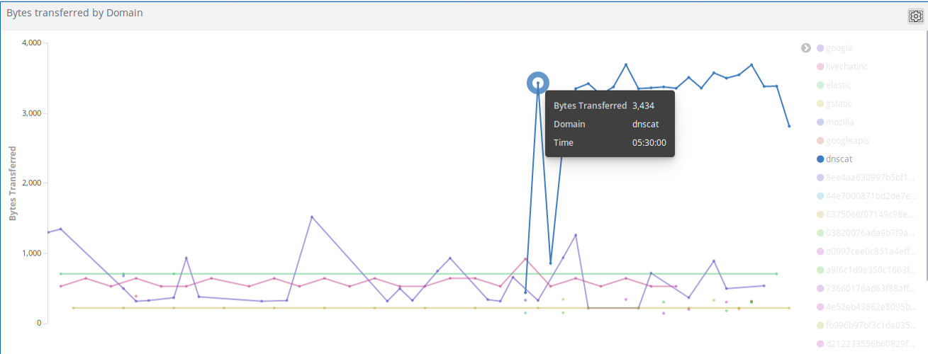
Detection Metric 2 - Increase in Bytes Transferred

Slide 14
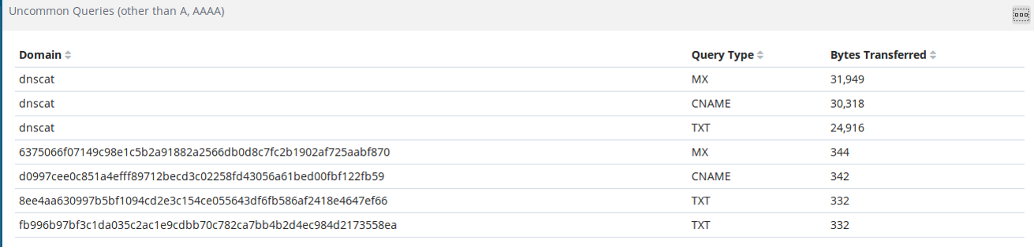
Detection Metric 3 - Anomalous Queries

Slide 15
Demo Time
This is not rocket science.

Slide 16
Visual Inspection
Legitimate DNS Traffic | Tunneled DNS Traffic
DNS requests will always go through the internal DNS servers. | DNS requests can (but don’t need to) bypass the local DNS server.
Hostnames will look like/include dictionary words. | Hostnames will look nothing like words a human can read (high level of entropy).
Short-ish DNS queries and responses. | Very long DNS queries and responses.
Small percentage of numerical characters in hostnames. | High percentage of numerical characters in hostnames.
Hostnames are unlikely to include repeated consonants, or blocks including only consonants and numbers. | Hostnames will very frequently include repeated consonants, and/or blocks including only consonants and numbers.
DNS records will likely be of most common types ie: A records, MX records and so on. | Likely use uncommon DNS record types heavily. Ie: TXT records.
DNS traffic to different IPs /domains will be somewhat “even”. | Very high volume of DNS traffic to a single IP and/or domain is likely (but not mandatory)
Likely to show just a few hostnames per domain. | Likely to show a huge number to hostnames per domain.
A DNS request is preceded by another request from some application. | A DNS request unlikely to be preceded by another request from some application.

Slide 17
PNG & ICMP attacks
Delivering payloads using PNG file
Data Exfiltration over ICMP
Detection Metrics

Slide 18
Delivering payloads using PNG file
A PNG file is an image file stored in the Portable Network Graphic (PNG) format. It contains a bitmap of indexed colors and uses lossless compression, similar to a .GIF file but without copyright limitations. PNG files are commonly used to store graphics for web images.
Why PNG ?
Image files are not monitored nor scanned. It can be hosted on any legit sites which are allowed in corporate.

Slide 19
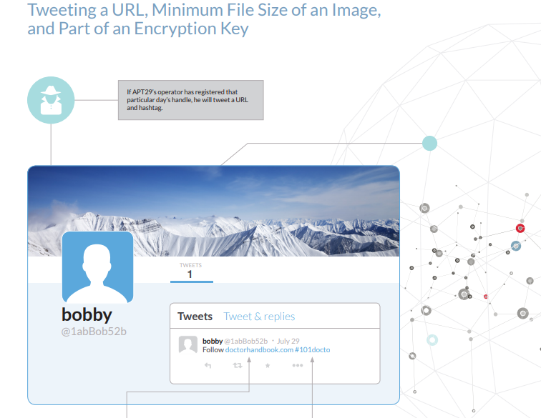
HAMMERTOSS: Stealthy Tactics Define a Russian Cyber Threat Group
https://assets.documentcloud.org/documents/2186063/apt29-hammertoss-stealthy-tactics-define-a.pdf

Slide 20
Data Exfiltration over ICMP
Internet Control Message Protocol (ICMP) is a TCP/IP network layer protocol that provides troubleshooting, control and error message services. ICMP is most frequently used in operating systems for networked computers.
Why ICMP?
ICMP packets are rarely monitored.

Slide 21
Cyber Espionage is Alive and Well: APT32 and the Threat to Global Corporations
PHOREAL | C2 Communication via ICMP Reverse shell creation File system manipulation Registry manipulation Process creation File upload
https://www.fireeye.com/blog/threat-research/2017/05/cyber-espionage-apt32.html

Slide 22
Demo Time
This is not rocket science.

Slide 23
Detection Metrics
Encrypted/Plaintext ICMP echo packets
Spike in ICMP packet byte count across normal traffic patterns
Lots of echo request to one Domain/IP
ICMP packet size outside the normal distribution
Pattern of many requests to specific domain/ip
PowerShell process making HTTP/HTTPS request to image file.

Slide 24
Demo Time
This is not rocket science.

Slide 25
Credits
Thanks to @NullMumbai for granting me the privilege to present.

Slide 26
Reference
https://www.blackhillsinfosec.com/powershell-dns-command-control-with-dnscat2-powershell/
https://github.com/peewpw/Invoke-PSImage
https://github.com/inquisb/icmpsh
http://www.labofapenetrationtester.com/2015/05/week-of-powershell-shells-day-5.html

Slide 27
THANKS!
Any questions?
You can find me at @chiragsavla94

